Slide 1
Gradient Boosting for Regression and Classification

Slide 2
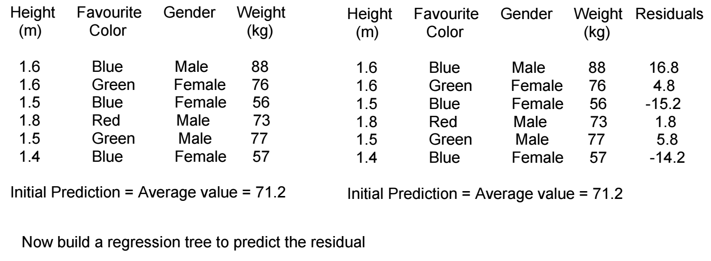

Slide 3
Gender
Updated prediction for 1st example
= Initial prediction + learning rate X Predicted by tree
= 71.2 + 0.1 X 16.8
= 72.9
New residual for 1st example
= 88 – 72.9 = 15.1
Updated prediction for 2nd example
= Initial prediction + learning rate X Predicted by tree
= 71.2 + 0.1 X 4.8
= 71.68
New residual for 2nd example
= 88 – 71.68 = 4.3
Female
Male
Heig
Color not Blue
Height<1.6
Yes
No
Yes
No
-14.2, -15.2 4.8 1.8,5.8 16.8
Avg = -14.7 Avg = 3.8

Slide 4
Gender
Height (m) | Favorite Color | Gender | Weight (kg) | Residuals after 1st iteration
1.6 | Blue | Male | 88 | 15.1(72.9)
1.6 | Green | Female | 76 | 4.3(71.68)
1.5 | Blue | Female | 56 | -13.7(69.7)
1.8 | Red | Male | 73 | 1.4(71.6)
1.5 | Green | Male | 77 | 5.4(71.6)
1.4 | Blue | Female | 57 | -12.7(69.7)
Female
Male
Heig
Color not Blue
Height<1.6
Yes
No
Yes
No
-12.7,-13.7 4.3 1.4,5.4 15.1
Avg = -13.2 Avg = 3.4
Updated prediction for 1st example = First guess + 0.1 x prediction by 1st tree + 0.1 x prediction by 2nd tree
= 71.2 + 0.1x16.8 +0.1x15.1
= 74.4
Updated prediction for 3rd example = First guess + 0.1 x prediction by 1st tree + 0.1 x prediction by 2nd tree
= 71.2 + 0.1x(-14.7) +0.1x(-13.2)
= 68.41

Slide 5
Height (m) | Favorite Color | Gender | Weight (kg) | Residuals after 2nd iteration
1.6 | Blue | Male | 88 | 13.6
1.6 | Green | Female | 76 | 3.9
1.5 | Blue | Female | 56 | -12.4
1.8 | Red | Male | 73 | 1.1
1.5 | Green | Male | 77 | 5.1
1.4 | Blue | Female | 57 | -11.4
Now build a 3rd regression tree to predict the latest residuals.
Now prediction of an example = Initial guess + 0.1x prediction by 1st tree + 0.1x prediction by 2nd tree + 0.1x prediction
by 3rd tree + ………….. so on until the maximum number of iteration is done or the updated residuals become insignificant

Slide 6
Gradient Boost for Classification
Loves Popcorn | Favorite Color | Age | Loves Troll2 | Residuals after initial guess
1.6 | Blue | 12 | Yes | 0.3
1.6 | Green | 87 | Yes | 0.3
1.5 | Blue | 44 | No | -0.7
1.8 | Red | 19 | No | -0.7
1.5 | Green | 32 | Yes | 0.3
1.4 | Blue | 14 | Yes | 0.3
Log of odds = log(4/2) = 0.7
Probability of loving Troll2 = 1/(1+e-0.7) = 0.7

Slide 7
Color = Red
Yes
No
Value for each leaf
Sum(Residuals)
Age > 37
Heig
-0.7
-3.3
=
sum{ (Previous probability)(1- Previous probability)
Yes
No
Value for 3rd leaf
0.3+0.3+0.3
0.3,0.3,0.3
0.3, -0.7
1.4
-1
=
0.7(1-0.7) + 0.7 (1-0.7) + 0.7 (1-0.7)
Log odds for 1st example = 0.7 + 0.8 x 1.4 = 1.8
Probability pf loving Troll2 = 1/(1+e-1.8) = 0.9
= 1.4
Log odds for 3rd example = 0.7 + 0.8 x (-1) = -0.1
Probability pf loving Troll2 = 1/(1+e0.1) = 0.5

Slide 8
Loves Popcorn | Favorite Color | Age | Loves Troll2 | Residuals after 1st iteration
1.6 | Blue | 12 | Yes | 0.1
1.6 | Green | 87 | Yes | 0.5
1.5 | Blue | 44 | No | -0.5
1.8 | Red | 19 | No | -0.1
1.5 | Green | 32 | Yes | 0.1
1.4 | Blue | 14 | Yes | 0.1
Probability after
1st iteration
0.9
0.5
0.5
0.1
0.9
0.9

Slide 9
Age <66
No
Yes
Value for each leaf
Sum(Residuals)
Age > 37
Heig
0.5
2
=
sum{ (Previous probability)(1- Previous probability)
Yes
No
Value for 3rd leaf
0.1-0.1+0.1+0.1
0.1,-0.1,0.1,0.1
-0.5
0.6
-2
=
0.9(1-0.9) + 0.1 (1-0.1) + 0.9 (1-0.9) + 0.9(1-0.9)
Log odds for 1st example = 0.7 + 0.8x1.4 + 0.8 x 0.6 = 2.3
Probability of loving Troll2 = 1/(1+e-2.3) = 0.91
= 0.6
Log odds for 3rd example = 0.7 + 0.8 x (-1) + 0.8 x (-2) = -1.7
Probability pf loving Troll2 = 1/(1+e1.7) = 0.15

